Slide 1

CS-130
Legal Issues in Computing -
Intellectual Property and Software

Slide 2

Learning Goals
What is Intellectual Property?
What are the major Intellectual Property laws and how do they affect computer scientists?
What is a monopoly, why don’t we want one, and when do we allow one to exist?
Why is Intellectual Property law controversial?
What is the Open Source movement and why is it Libre, not just Gratis?
Notes:
Tran – violating this requires some form of eavesdropping…..

Slide 3
How many types of laws relating to intellectual property can you think of?

Slide 4
Intellectual Property Laws
Trade Mark – a graphical image or a word under which a particular person or organisation is well-known
Trade Secret – A process or formula which is a closely guarded secret (no time limit)
Patents – A novel and non-obvious design for a limited time period
Copyright – A legal restriction on the copying of music or literary works

Slide 5
Intellectual Property Laws
Trade Mark – a graphical image or a word under which a particular person or organisation is well-known
Trade Secret – A process or formula which is a closely guarded secret (no time limit)
Patents – A novel and non-obvious design for a limited time period
Copyright – A legal restriction on the copying of music or literary works

Slide 6
Patent
Granted when you present the patent office in your country a novel and non-obvious design
Has been applied to more than just inventions
Algorithms and business methods/models have been patented in some countries
The reward for the inventor - in return for publishing details the inventor is granted, for a limited time, and in a limited geographic jurisdiction, a monopoly on the use or the sale of their idea

Slide 7
Copyright
Literary and artistic creations are protected from duplication for a limited (variable) period (often authors life plus 50 years)
The creator has the right to charge for duplication or refuse permission for “derivative work” or “public performance”
Copyright is automatically granted on any work you author
Copyright belongs to your employer when you are working for them “in the course of employment”
This raises some issues about working in your free time on other projects when your hours aren’t clearly defined

Slide 8
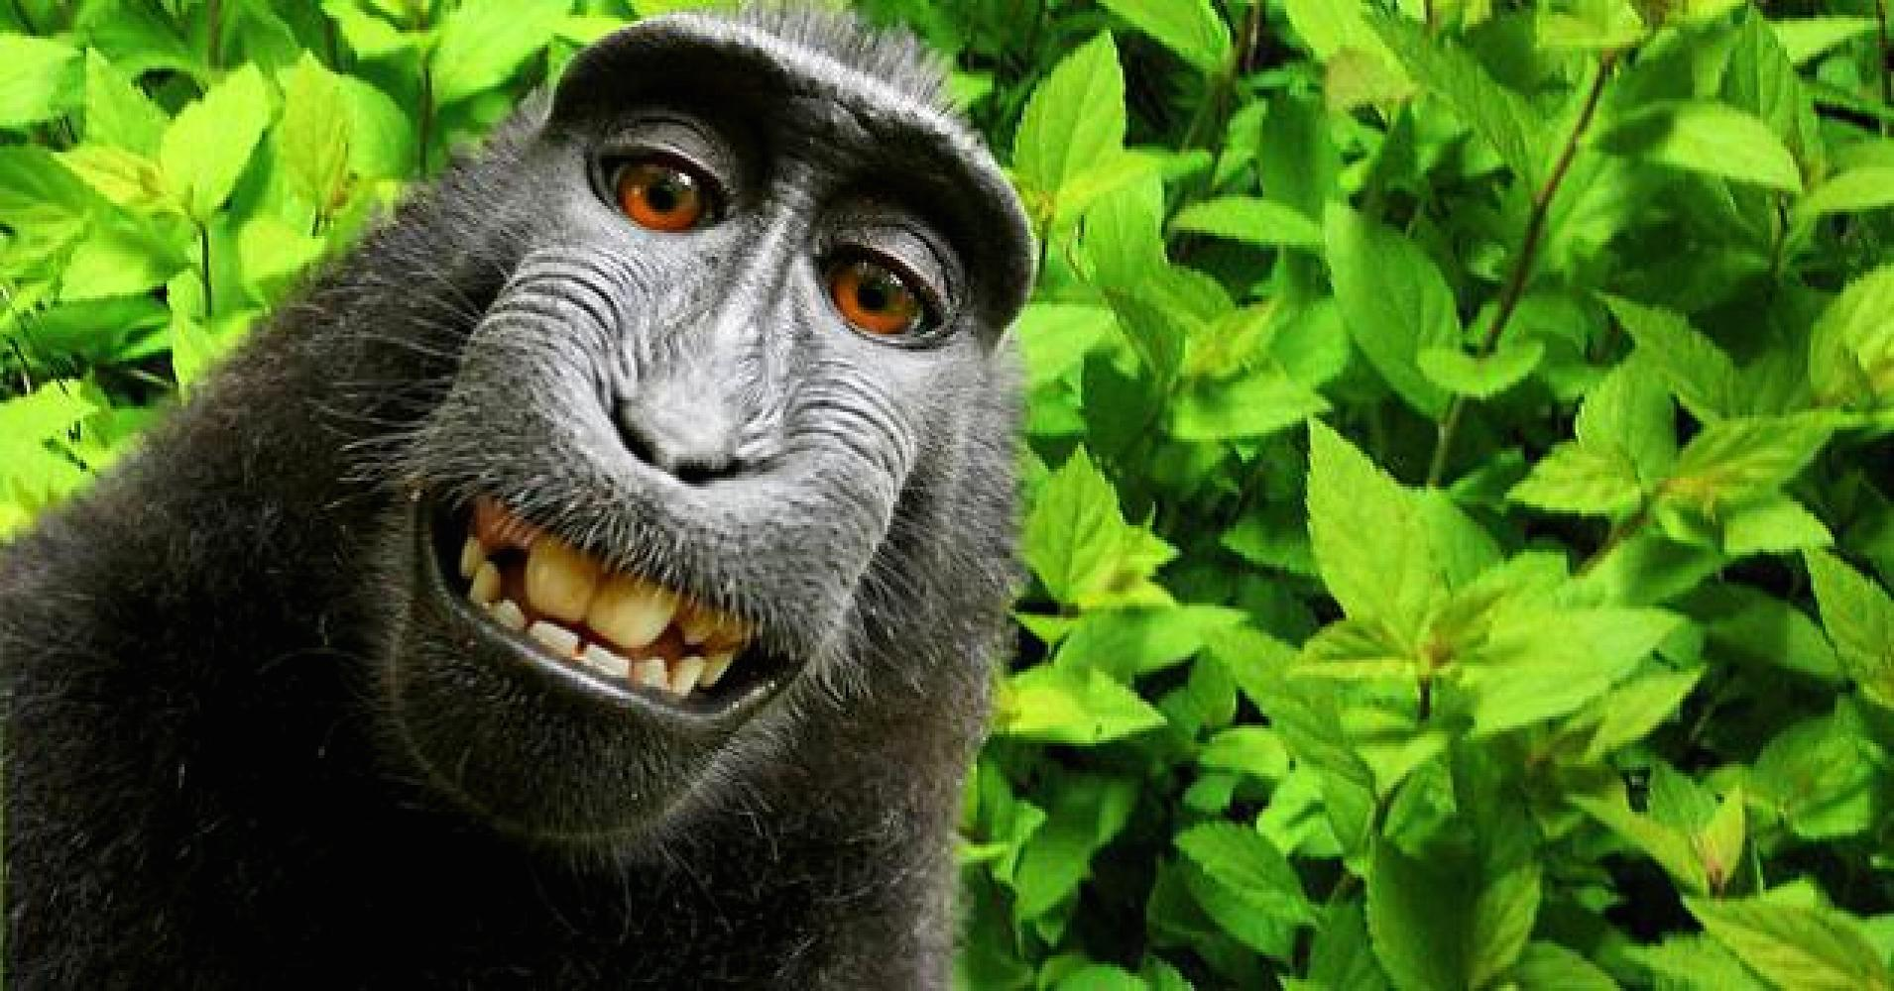

Slide 9
Philosophical Basis
The US Congress has “the right to promote the progress of science and the useful arts by securing for limited times to authors and inventors the exclusive right to their respective writings and discoveries
In the UK, the 1624 Statute of Monopolies made them illegal except in certain specified circumstances, including a 14 year monopoly for new and inventive practices
14 years = length of two apprenticeships

Slide 10
Key concept - Monopolies
Monopolies are “the exclusive possession or control of the supply of or trade in a commodity or service”
Monopolies are formed through horizontal and vertical convergence
Why do Governments not like monopolies?
The enable price fixing
Supply inferior products
They reduce innovation
They can drive inflation
As a result, monopolies are usually illegal due to antitrust laws

Slide 11
What makes digital technology so much more challenging to govern with Intellectual Property law?

Slide 12
Digital Technology and IP Issues
Physical goods no longer primary “things of value” in the digital media world or the “information Age” so old laws are hard to apply
Digital, infinitely copy-able without degradation and easily distributable
The speed of change in the field is incredible compared to when laws were first made

Slide 13
Modern Patent Systems
Invention must be novel and non-obvious. Demonstrate a working prototype and lodge a description
In exchange for the publication of the system, you receive a monopoly on the use in exchange of usually about 20 years.
Improvement Patents
Holder cannot sell improved device without original patent holder’s permission
Original holder cannot sell improved device without improvement patent holder’s permission.
Patent holder under no obligation to grant any licence
Even if they don’t use it themselves

Slide 14
Technology and the Term of a Patent
The original Term of Monopoly for a patent (how long it lasts) was 14 years so the Internet has been in existence for only two patent lifetimes
But the World Wide Web has ben here less than one….
VisiCalc – first spreadsheet software
If it had been patented would only have dropped its patent in 1999
Enhancement patents would still be in force.
New methods and technologies still developed at increasing speeds
In this environment, the question is if a 25 ort even 20 year Patent is useful

Slide 15
Software Patents
Software was originally embedded in computers – it wasn’t so “soft”
Costs of software trivial compared with cost of machine and so became regarded as part of the machine
Viewed as provided by manufacturers to sell their machines
Key debates around software patenting
Obviousness and inventiveness – what if someone patents the for loop?
Overlap with copyright – code is already protected from direct copying
Interoperability – why doesn’t everyone use GIF or PNG?
Patent trolling – companies that only buy patents in the United States to sue other companies

Slide 16
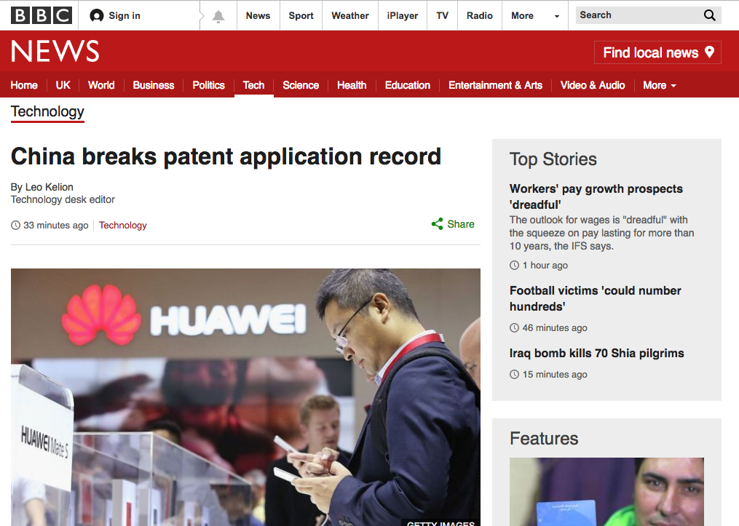

Slide 17
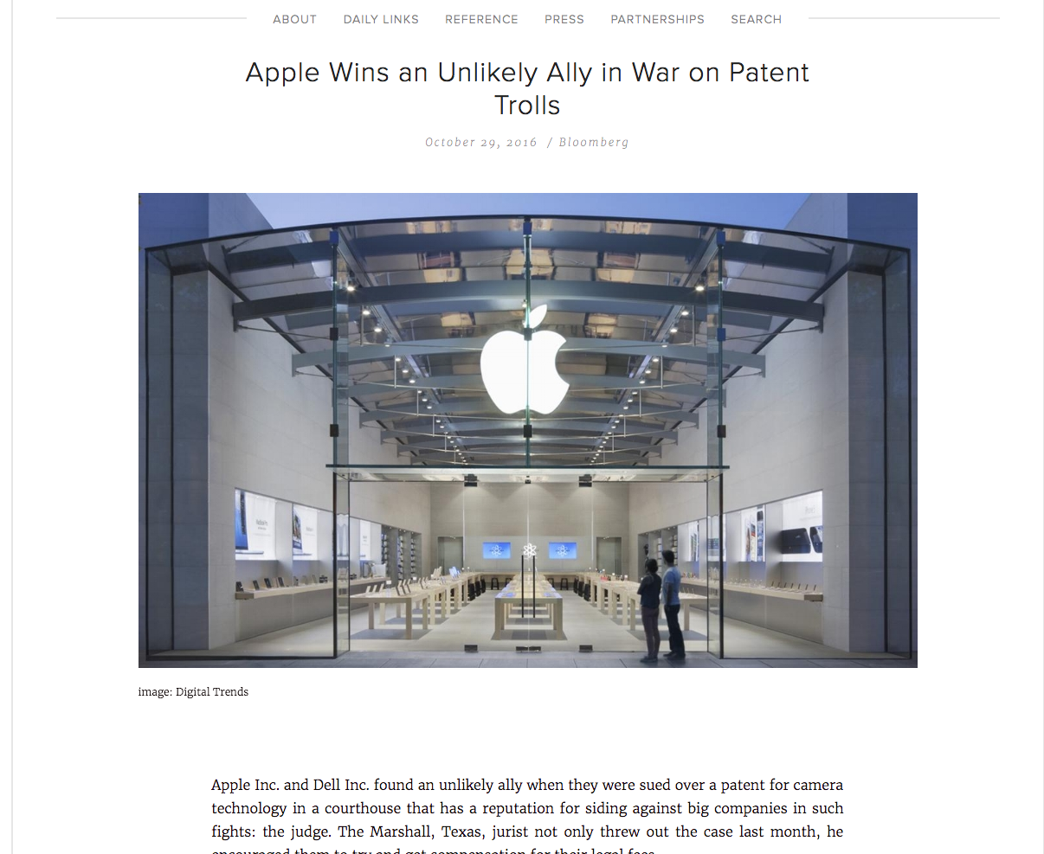

Slide 18
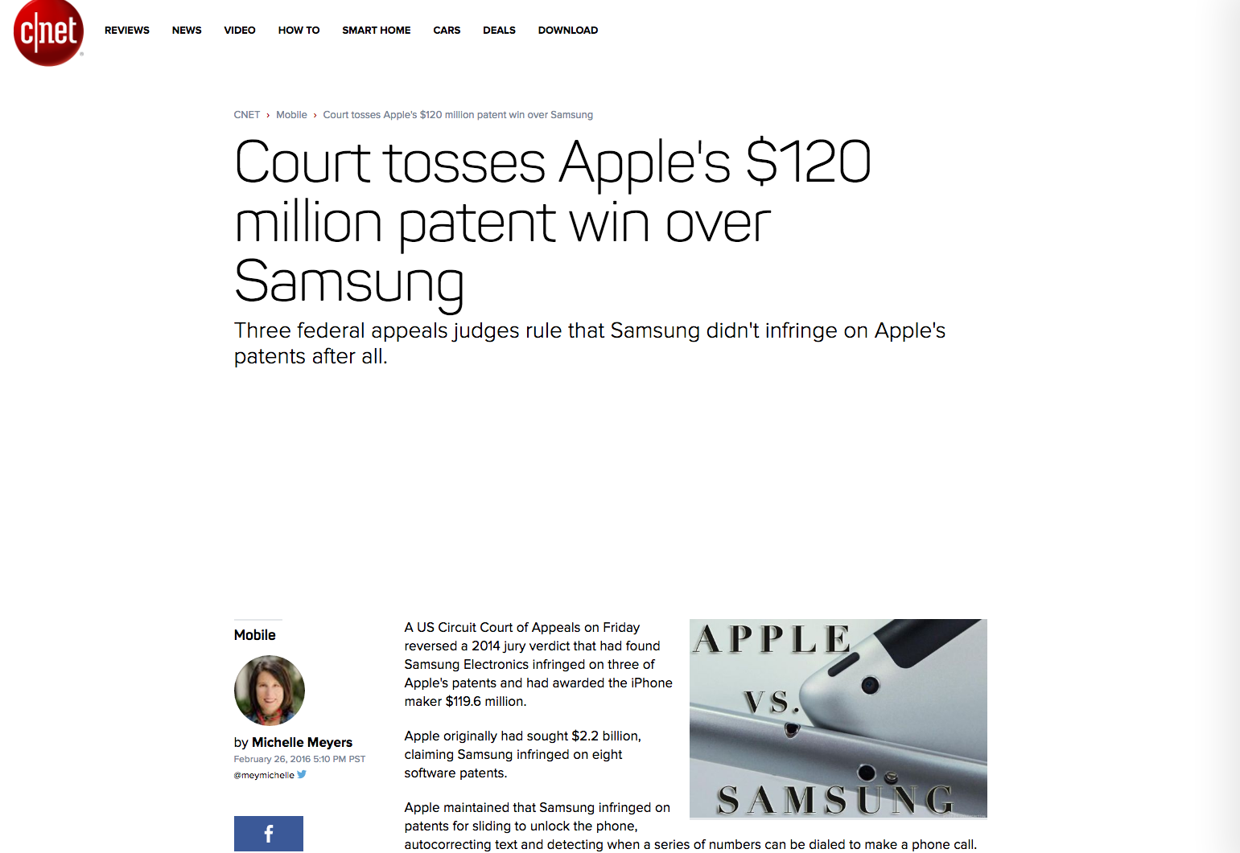

Slide 19
Detractors of IP law
“He who receives an idea from me, receives instruction himself without lessening mine; as he who lights a taper at mine, receives light without darkening me”
– Thomas Jefferson 1813.

Slide 20
Who Do They Protect/benefit?
George Michael compared his record contract with Sony to slavery
Janis Ian says she would rather get $2 each DVD by selling thousands directly herself, than get $0.05 per CD on a recording contract
In contrast, CryTek, makers of the Crysis games said at one point pirated copies of Crysis outnumbered legitimate copies 15 to 1
The cost to the economy of Piracy is extremely hard to pin down
Sone argue there is no cost – why?
The rise in popularity of “Digital Platforms” is in no small part because it can be harder to pirate material on them

Slide 21









Prominent computing technologies involved in
antitrust lawsuits

Slide 22
Prominent computing technologies not involved
In antitrust lawsuits

Slide 23
To what extent should you be able to patent software?

Slide 24
The Open Source Movement
Gratis vs Libre: “Free as in free speech, not as in free beer”
Open Source technologies are available under a license that requires only that you make improvements to that technology freely available
Linux, Apache Foundation and Web Server, Mozilla, Chromium, Libre Office, Android
Open Standards – HTTP, UML, PNG, PDF
Not just about software too
Open Hardware – Arduino platform you may use
And more – Open Medicine, Open Content, Open Beer(!)

Slide 25
The Open Source Movement
However, Open Source is not about giving thigs away for free and doing charitable work!
Companies need to be able to make money from their ideas if they are to be supported, so why would you give away the software for free?
Others can use your platform more easily
They even improve it and have to release those improvements (the best encryption is Open Source encryption)
Hobbyists and educators use your platform and then turn to it
As a result, your platform spreads more rapidly than the competition
You then sell support and expertise with the software in the hopes it becomes the best in the field!

Slide 26
Licensing
If you want to use other people software you need to buy it, or licence it from them
This is a challenge if you want to start up a small company sometimes
Software licences can be costly, typically paid out on a per-user basis
But there are consequences if you don’t pay for it and get caught
A final note: Free software licences are not the same as Open Source licences
Some limit the item to academic or personal use (why?)
Others can require a share of financial rewards

Slide 27
Learning Goals
What is Intellectual Property?
What are the major Intellectual Property laws and how do they affect computer scientists?
What is a monopoly, why don’t we want one, and when do we allow one to exist?
Why is Intellectual Property law controversial?
What is the Open Source movement and why is it Libre, not just Gratis?
Notes:
Tran – violating this requires some form of eavesdropping…..

